Slide 1
Epidemics on Hypergraphs
4/6/2023

Slide 2
Introduction to Hypergraphs
A pair H=(V,E) is a hypergraph if V is a set and E is a set of subsets of V.
V -> Nodes. E-> Hyperedges.
Hyperedges of cardinality 2 represents a graph. Hyperedges of size k represent a k-uniform hypergraph.
Degree of a node is the number of hyperedges adjacent to that node. If every node of a hypergraph has same degree d, it is a d-regular hypergraph.
The distance between 2 nodes u and v of a hypergraph is the length of the shortest path between them and is denoted by dist(u,v)

Slide 3
Clique Expansion- Graph representation on the same nodes
Let H=(V,E) be a hypergraph. The clique expansion graph G^{H} = (V^{H}, E^{H}) of H is represented by setting V^{H} =V for all hyperedge h and creating a clique of all the nodes contained by h.
Here, multi-edges between vertices are allowed, there are k parallel edges between a pair of vertices if exactly k hyperedges contain the 2 vertices.
Clique expansion graph of a hypergraph => clique graph of hypergraph

Slide 4
Real World Hypergraphs
Clustering Coefficient:
In Graphs:
In Hypergraphs:
K-Uniform
Not K-Uniform

Slide 5
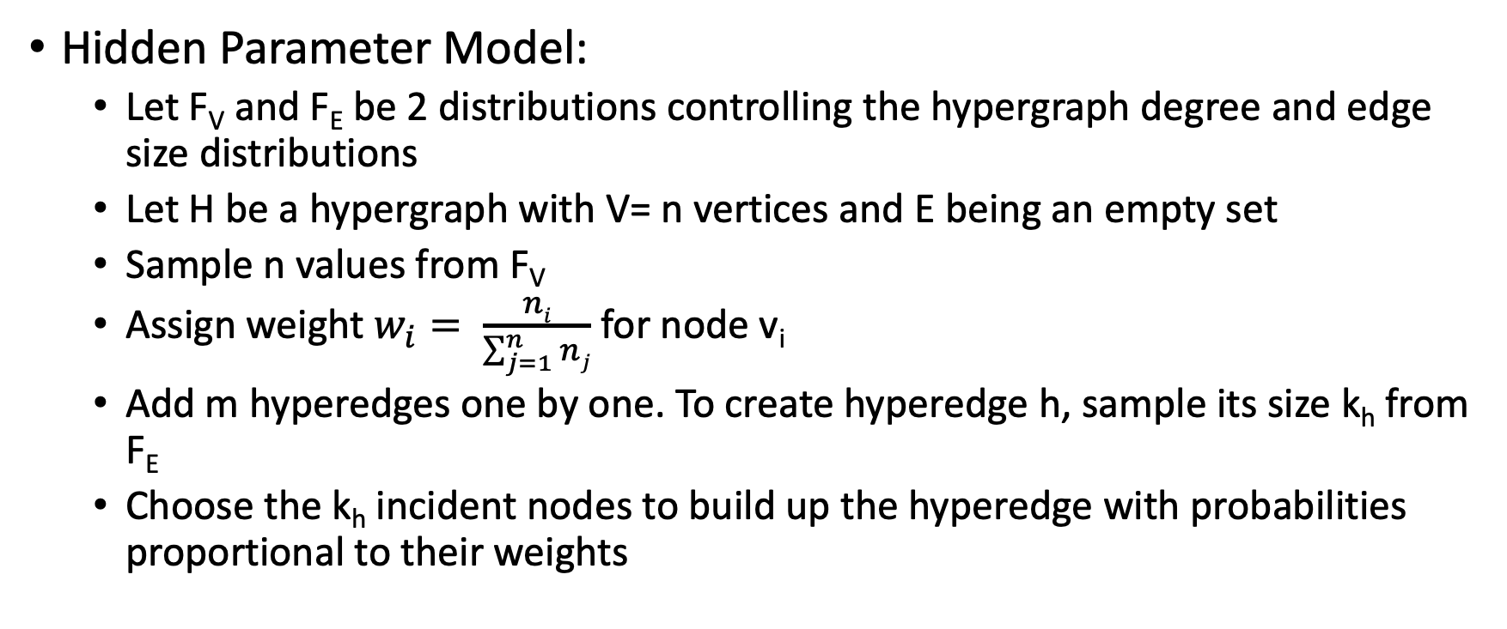
Generating hypergraphs
Hidden Parameter Model:
Let F_{V} and F_{E} be 2 distributions controlling the hypergraph degree and edge size distributions
Let H be a hypergraph with V= n vertices and E being an empty set
Sample n values from F_{V}
Assign weight $w_{i}= \frac{ni}{\sum_{j=1}^{n}{nj}}$ for node v_{i}
Add m hyperedges one by one. To create hyperedge h, sample its size k_{h} from F_{E}
Choose the k_{h} incident nodes to build up the hyperedge with probabilities proportional to their weights

Slide 6
Other Methods
Barbasi-Albert Model
Bianconi Barabasi Model
Erodos- Renyi Model (random Hypergraphs)

Slide 7
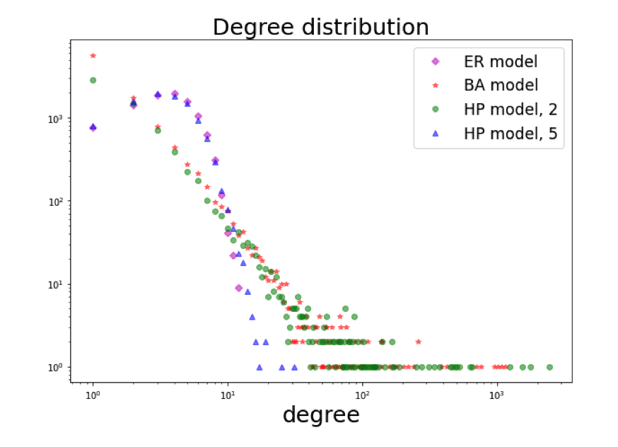
Generating a Erdos- Renyi Hypergraph
The degree distribution of Erdős-Rényi hypergraph is from a H[10000, 10000, 5]. For the two Hidden parameter model hypergraphs we chose F_{V} to be a power law distribution with parameter α, where α = 5 for the blue and α = 2 for the green one. The Barabási-Albert model is with n = 10000, m = 1, k = 5.

Slide 8
Eigenvector Centrality – Important Nodes
For graphs, the Perron eigenvector of the adjacency matrix assigns a value for each node in a graph (eigenvector centrality).
Hypergraphs?
Calculate the spectral centrality of the hypergraph using some of its expansion graphs like the clique graph
Using higher dimension adjacency tensor of the hypergraph (the hypergraph needs to be k-uniform).
We can also calculate node centrality of hypergraphs using 4 nonlinear functions.

Slide 9
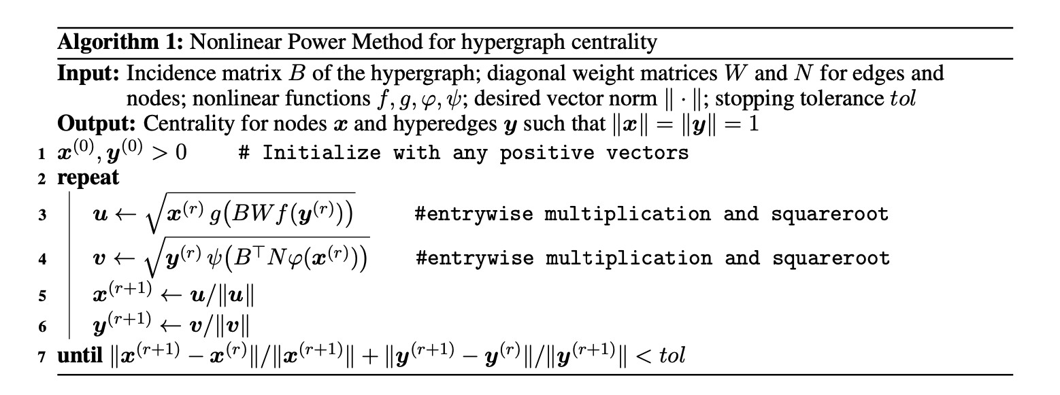
Hypergraph Centrality

Slide 10
Modelling COVID-19 Pandemic spread using Hypergraph
Build a stochastic model for spread of COVID
Stratify population into 5 age groups (older people are more affected)
Community structure: # of communities a person is a part of depends on his/her age.
States:
Susceptible
Exposed
Asymptomatic infectious
Symptomatic infectous
Recovered
Dead
Population is a hypergraph with nodes as individuals and communities/ gatherings being hyperedges

Slide 11
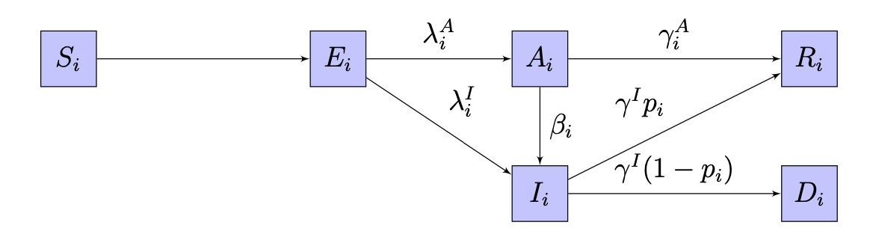
Compartmental model for nodes g_{v}=i

Slide 12
Underlying Hypergraph Structure
There are n=|V| nodes. Let us define an ‘age’ function on the nodes categorizing individuals to age groups
3 types of hyperedges (households, workplaces and events)
The household and workplace hyperedges are generated by the d-regular hypergraph generation process. Here d=2. The event hyperedges are generated using the Bianconi-Barbasi model

Slide 13
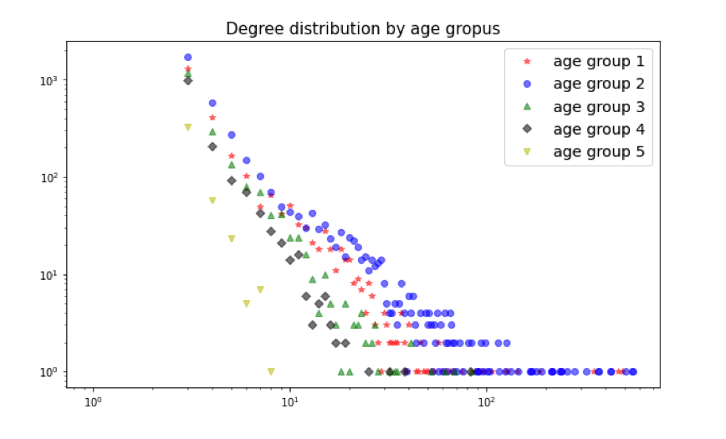
Degree vs Frequency

Slide 14
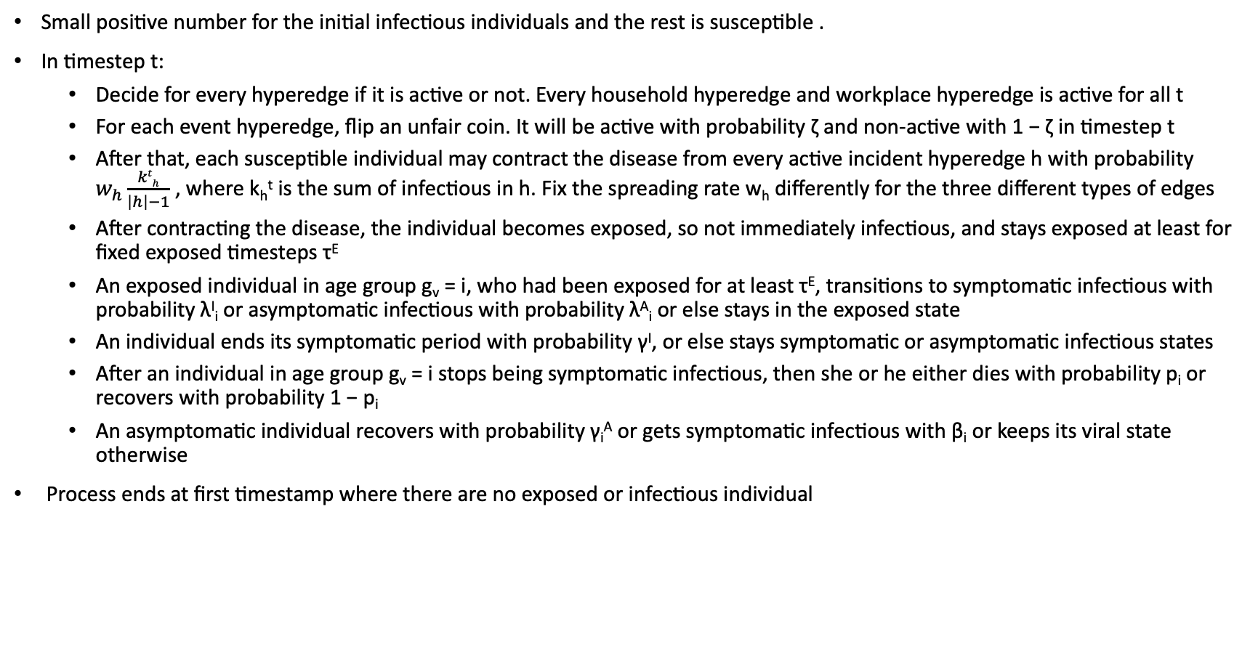
Process
Small positive number for the initial infectious individuals and the rest is susceptible .
In timestep t:
Decide for every hyperedge if it is active or not. Every household hyperedge and workplace hyperedge is active for all t
For each event hyperedge, flip an unfair coin. It will be active with probability ζ and non-active with 1 − ζ in timestep t
After that, each susceptible individual may contract the disease from every active incident hyperedge h with probability $w_{h}\frac{kth}{\left|h\right|−1}$ , where k_{h}^{t} is the sum of infectious in h. Fix the spreading rate w_{h} differently for the three different types of edges
After contracting the disease, the individual becomes exposed, so not immediately infectious, and stays exposed at least for fixed exposed timesteps τ^{E}
An exposed individual in age group g_{v} = i, who had been exposed for at least τ^{E}, transitions to symptomatic infectious with probability λ^{I}_{i} or asymptomatic infectious with probability λ^{A}_{i} or else stays in the exposed state
An individual ends its symptomatic period with probability γ^{I}, or else stays symptomatic or asymptomatic infectious states
After an individual in age group g_{v} = i stops being symptomatic infectious, then she or he either dies with probability p_{i} or recovers with probability 1 − p_{i}
An asymptomatic individual recovers with probability γ_{i}^{A} or gets symptomatic infectious with β_{i} or keeps its viral state otherwise
Process ends at first timestamp where there are no exposed or infectious individual

Slide 15
Effect of Wearing Masks
Two epidemic simulation on the same hypergraph model with a population size 10000. Stratified the population into 5 age group as we described before.
The fitness of the nodes was distributed according to their age, so the mid-age people had a higher chance to have more connections than the others
Started the simulations by being 5 infectious in the population and the rest susceptible
Set the spreading rates of the workplace and event hyperedges rather high to 0.5, this means if a susceptible person meets with 3 of his friends then he gets the virus with probability 1/6 if exactly one of them is infectious
Fixed the event hyperedge appearance probability ζ to 0.05

Slide 16
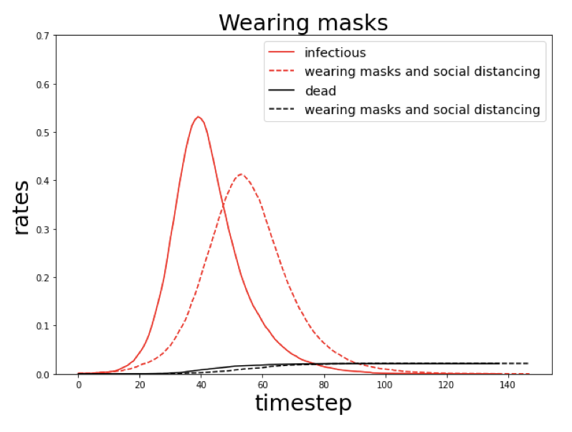
Wearing Masks
With the dashed lines the epidemic dynamics on the same hypergraph with different hyperedge spreading rate and appearance probability is shown
By the right hygienic precautions, social distancing and wearing masks, we can half the probability of getting the disease from our workplaces and events, so we set w_{wp} and w_{ev} to 0.25. At the same time by making responsible decisions the population avoids the events by half-chance than in the model presented on the right side, so we set ζ = 0.025
Conclusions:
Reducing the spreading probability is an effective method for flatten the infectious curve
So, this is related to healthcare capacity

Slide 17
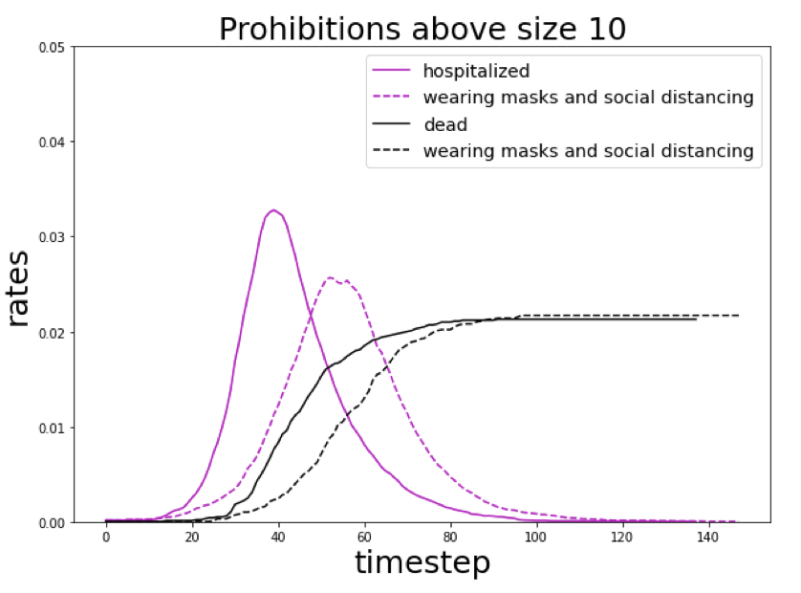
Rate of Symptomatic Infectious Individuals who need Hospitalization
On average 15.92% of the confirmed cases were needed hospitalization in the time period from 14.02.2021 till 16.05.2021 in Hungary. The author used this period for fitting the parameters
At this first time we can calculate the hospitalized people from the 15.92% of the symptomatic infectious. After that, we can draw the rates of the hospitalized individuals in the population for both epidemic spreads
Surprisingly, the number of deaths did not decrease after lowing the spreading rates and appearance probabilities. This could happen because the virus reached almost everyone in both cases so it ran through the population despite the active precautions
Effect: The delay in the peak of infectious and the lower maximum number of hospitalized people in one timestep. These two outcomes crucial to healthcare efficiency, because the later comes the peak the more time they have for preparations and if there are fewer people in the hospitals they have a better chance for recovery because of the supplies
The effects of wearing masks and social distancing on the healthcare system. Here we present the same runs as previously but different rates. The simple lines come from the case when there is no any precaution against the virus and the dashed ones when people wear masks and keep a safe distance.

